Slide 1
TrackFit DMQB Project 2
Comparison of Google Fit user data
Pierre Delpy
Priya Caspar Groß

Slide 2
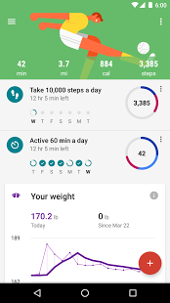
Aim of our application
Access Google Fit user data and store in database
Create summary statistics for all users in our database
Visualize your daily steps in comparison to all others in the database
Easily extendable and reusable

Slide 3
Frameworks used
Vaadin Web Application (Java)
1
User authentification Data request
Connection of modules
MongoDB
2
Data structure
Storage and handling
D3.js
3
Visualization

Slide 4
Please enter your title
Please enter the textPlease enter the text
A
Please enter the textPlease enter the text
Please enter the textPlease enter the text
B
C

Slide 5
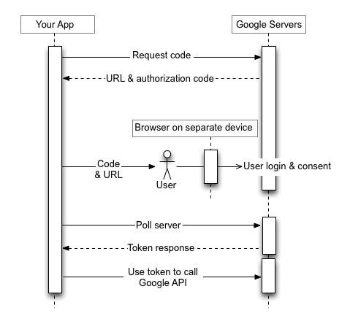
Authorization with Google OAuth2
User provides his Google username
User gets redirected google login/authorization page
User gives consent to requested data
TrackFit obtains acces Token from Google

Slide 6
Data request from Fit API
Uses standardized REST API Call
In thise case: Uses Google Rest Library for Java
Clusters data for days (last full finished day)
Data is received in JSON Format
JSON is sent to database handler

Slide 7
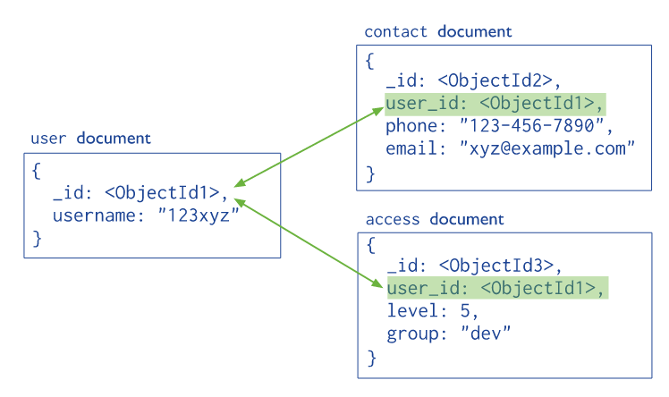
MongoDB
NoSQL database
Basic Structure: Collections and Documents
we used Java Driver version 3.4 for interacting with MongoDB

Slide 8
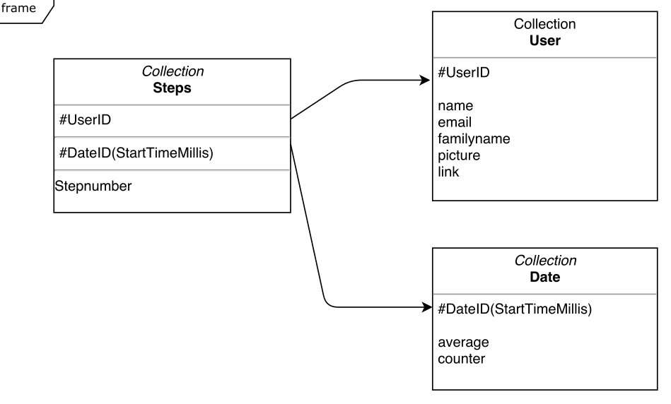
Data model
One database
3 Collections
Steps
Date
User

Slide 9
DB Monitoring with Compass
Screenshot

Slide 10

Data visualization
D3.js
Parsed JSON File
Graph

Slide 11
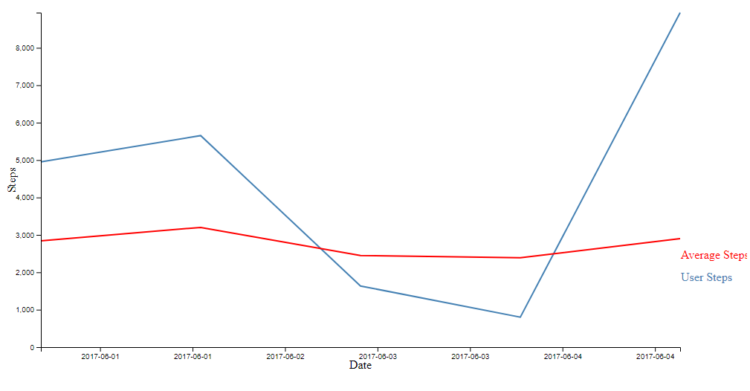
Graph
Picture of graph

Slide 12
Outlook
Further integration of additional functions
Integration into existing vaading structures
Other gadgets and fitness providers
Further improvement of our program might include other fitness data available on
google fit, like cycling or running data. A more complex improvement would be to also
include fitness data of other platforms like Withings or Fitbit

